Slide 1

Table of contents
Reactive Programming
Prerequisites Software & Tools
Project Structure
Configuration Files
Key Classes
Reactive Application Up & Running

Slide 2
Reactive Programming
Non-Blocking: Reactive programming is a declarative programming paradigm that is based on the idea of asynchronous event processing and data streams.
Asynchronous: Asynchronous processing means that the processing of an event does not block the processing of other events.
Back Pressure: The ability of the consumer to request items at different rates or only when it is ready to process them.
Event Driven: Web applications adopt non-blocking servers based on the event loop model.

Slide 3
Need for Reactive Programming
Most applications in a fast-paced world need to be reactive and users are expecting results within the next second after submitting the request. Hence there is a need to build a system that is highly reactive and executes the requests in parallel.
Spring reactive programming utilizes the netty server event loop model which saves the number of threads executing in memory, unlike the Spring MVC thread per request model.

Slide 4
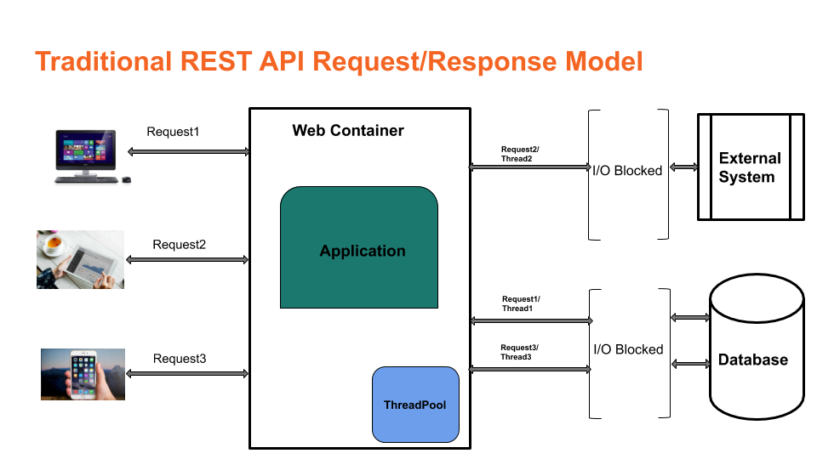

Slide 5
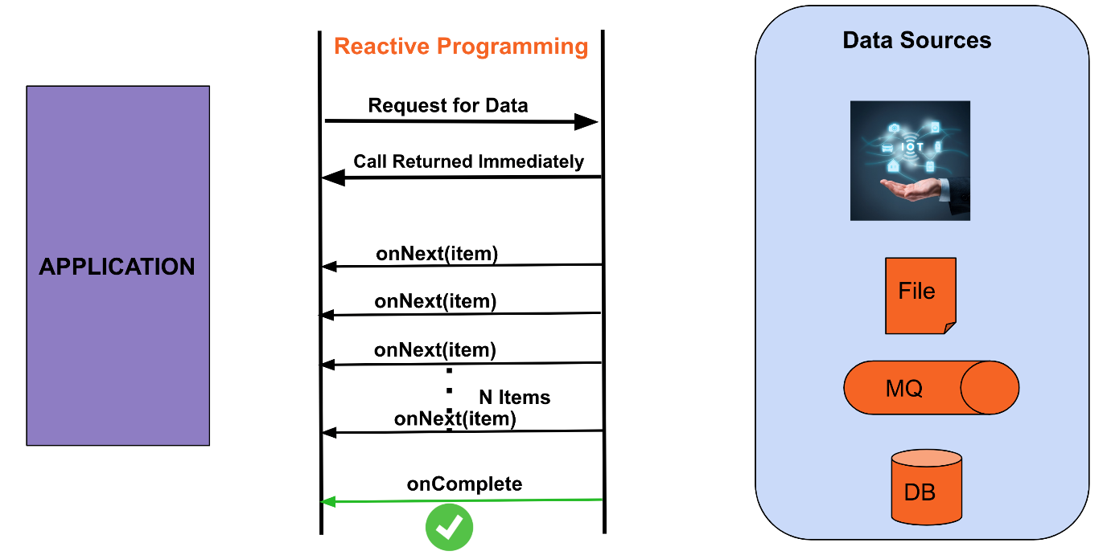

Slide 6
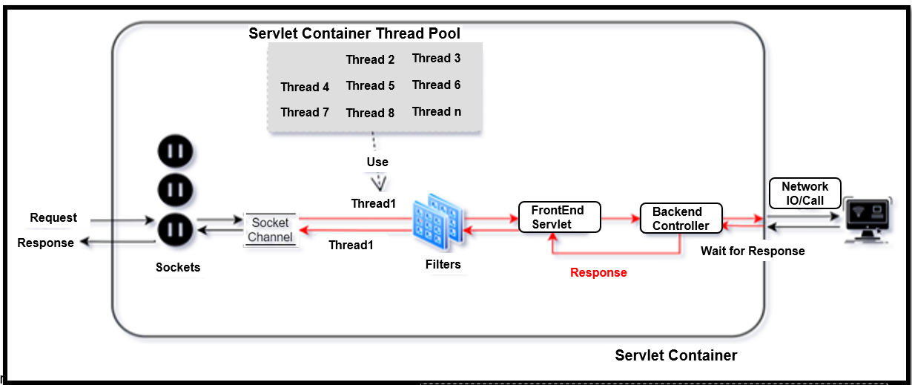
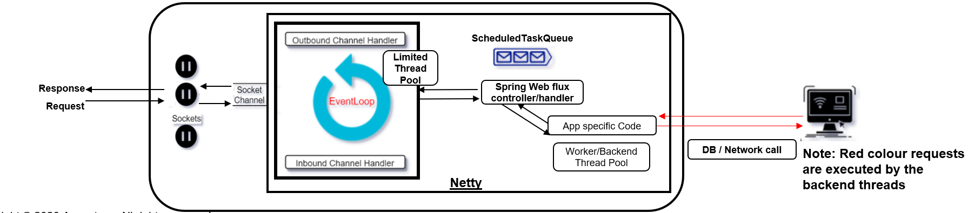
Spring web flux
Traditional Spring MVC Thread per request model
Spring Web flux Event loop Model
Spring web flux provides reactive programming support for web applications.

Slide 7
Benefits Of Reactive Programming
Move away
Move away from the thread per request model and can handle more requests with a limited thread pool.
Prevent
Prevent threads from blocking while waiting for I/O operations to complete hence maximum throughput can be achieved.
Make
Make it easy to do parallel calls.
Support
Support “back pressure”, giving the client a possibility to inform the server on how much load it can handle.
Better
Better user experience.

Slide 8
Spring Web Flux supports the Reactive Stream API, which is a standardized tool for processing asynchronous streams with non-blocking backpressure.
Reactive streams have a publisher (producer) — subscriber (consumer) model. The publisher emits an event, and a subscriber will read it. In the Reactive Streams API, there are four main interfaces:
Publisher — Emits events to subscribers based on the demands received from its subscribers. A publisher can serve multiple subscribers and it has only one method: subscribe
Subscriber — Receives events emitted by the Publisher. The subscribe has four methods to deal with the events received: onSubscribe, onNext, onError , and onComplete
Subscription — This represents the relationship between the subscriber and the publisher. It has methods that allow requesting for data request(long n) and to cancel the demand of events cancel()
Processor — Publisher and subscriber at the same time; rarely used.
Reactive Streams & Project Reactor

Slide 9
Spring Web Flux internally uses Project Reactor and its publisher implementations, Flux and Mono.
Mono — A publisher that can emit 0 or 1 element.
Flux — A publisher that can emit 0..N elements.
Mono and Flux offer simple ways of creating streams of data.
Reactor offers several operators for working with Flux and Mono objects. Most commonly used are:
Map — Used to transform the publisher elements to other elements
FlatMap — Similar to map, but the transformation is asynchronous
FlatMapMany — Mono operator used to transform a Mono into a Flux
DelayElements — Delays the publishing of each element by a given duration
Concat — Used to combine publishers’ elements by keeping the sequence of the publishers
Merge — Used to combine publishers without keeping the publishers’ sequence, instead it interleaves the values
Zip — Used to combine two or more publishers by waiting on all the sources to emit one element and combining these elements into an output value.
doOnError- we can invoke whatever action that is needed when there is an error.
onErrorResume: Gives a fallback stream when some exception occurs happens in the upstream.

Slide 10
Java 17
Maven
Docker Desktop
Postgres Database
Eclipse(Or Any other IDE )
Prerequisites Software & Tools

Slide 11
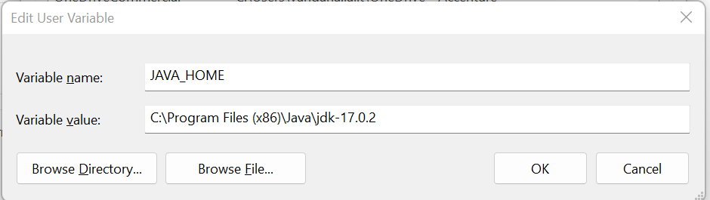
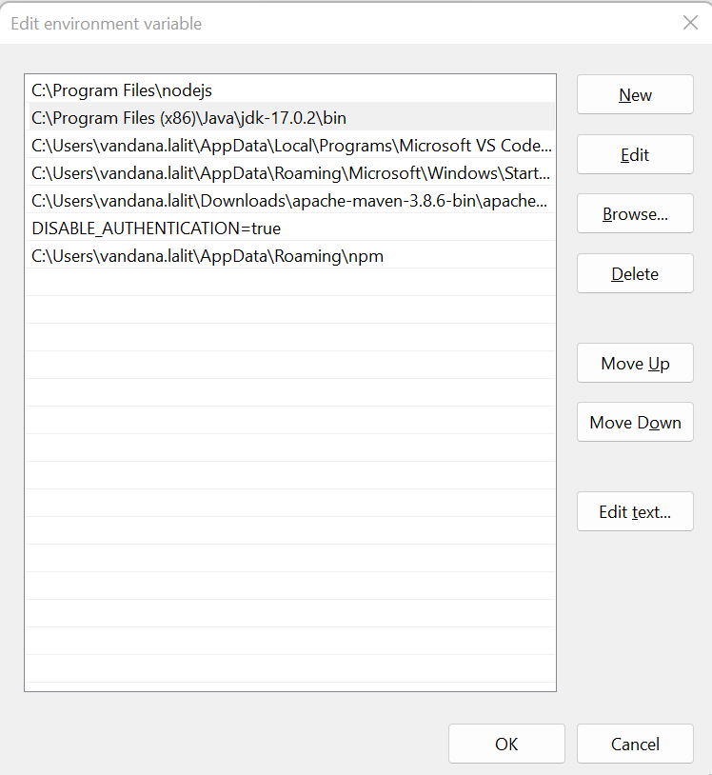
Download Java 17 from Java Archive Downloads - Java SE 17 (oracle.com)
Install Java 17 with the installer
Setup environment variable JAVA_HOME
Java 17 Installation &
Setup
Add Java to the path variable. For environment variables click on Path and edit.

Slide 12
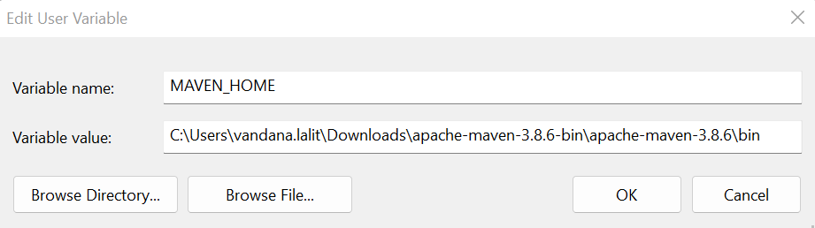
Download maven latest version from Maven – Download Apache Maven
Install maven with installer
Setup environment variable MAVEN_HOME
Maven Installation & Setup

Slide 13
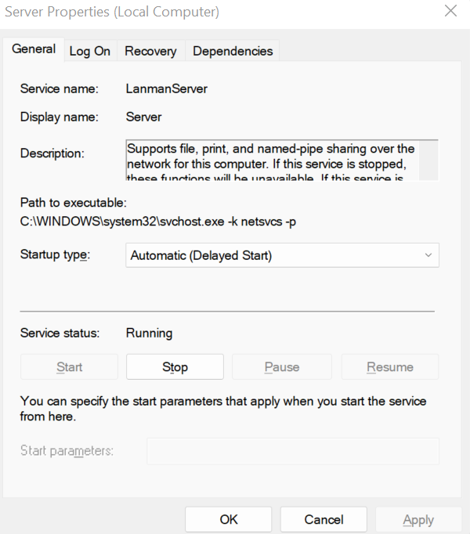
Docker Desktop:
Download Docker Desktop latest version from Download Docker Desktop | Docker
Install docker desktop with installer
Enable the server in services.msc
Docker Desktop
&
PostgreSql Installation & Setup
PostgreSQL:
Download Postgres latest version from PostgreSQL: Downloads
Install Postgres with the installer

Slide 14
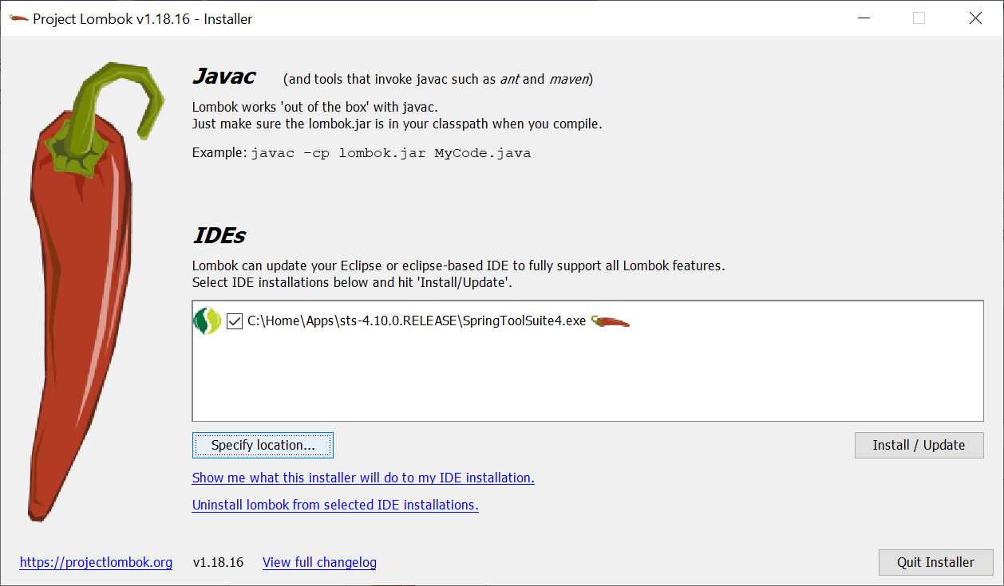
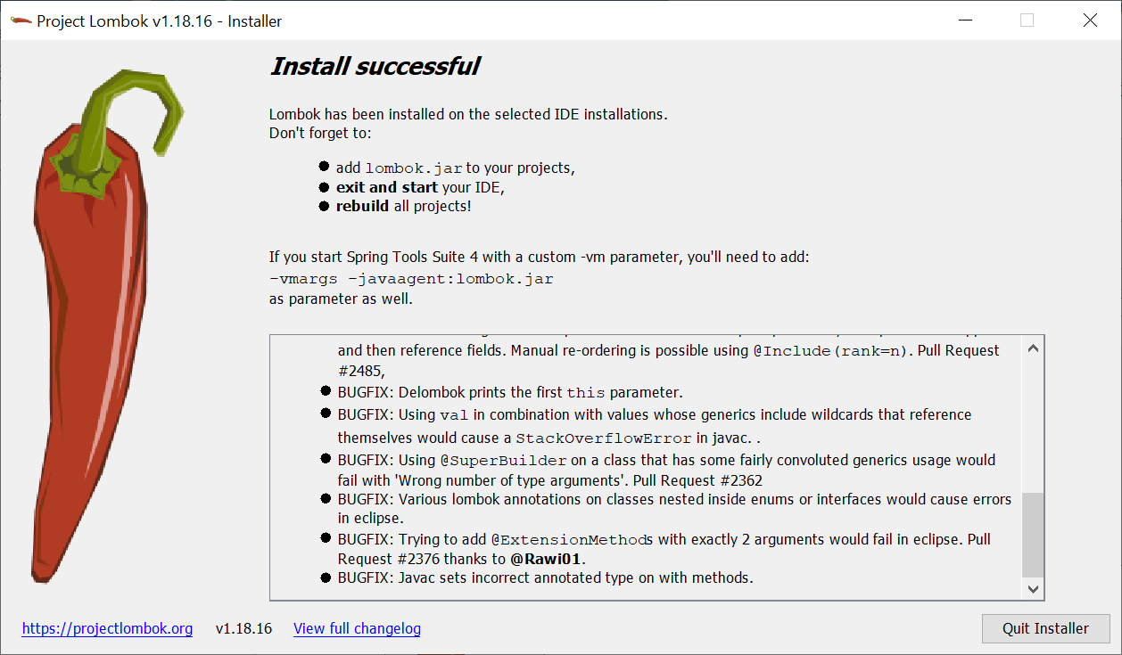
Download eclipse latest version from Eclipse Downloads | The Eclipse Foundation
Install eclipse with the installer
Configure projectlombok from following command
.m2\repository\org\projectlombok\lombok\1.18.16>java -jar lombok-1.18.16.jar
Eclipse IDE Installation & Setup

Slide 15
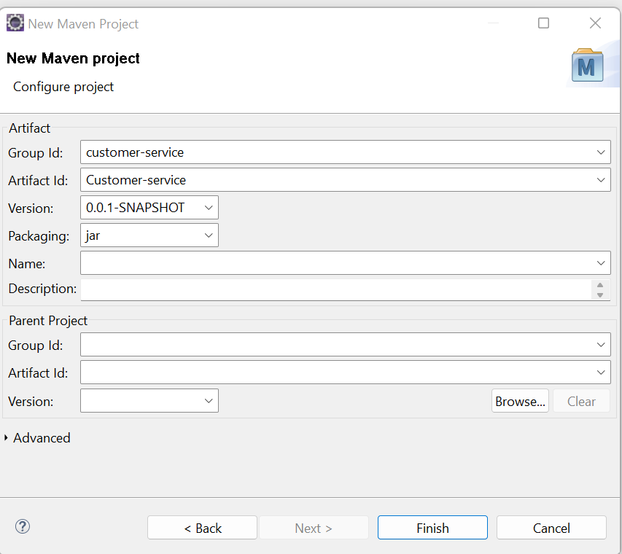
Create a new Maven Project
Project structure

Slide 16
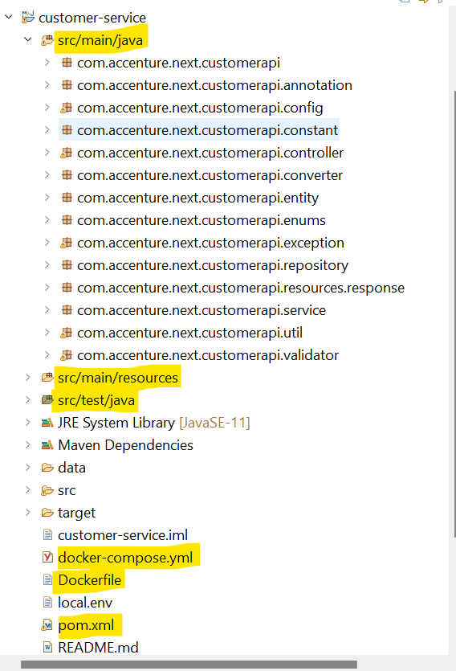
Contd..
Create the packages main (along with service package structure) and test packages
Project structure

Slide 17
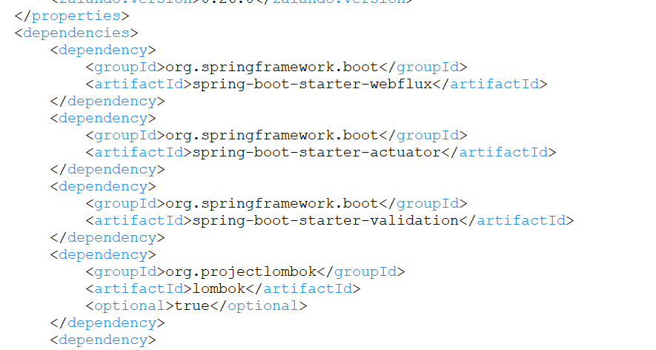
Pom.xml
Pom file includes all the project specific dependencies like Java 17, Spring Webflux, Project reactor, Zalando, PostgreSQL, r2dbc, Spring Boot validation, Junit, and Lombok.
This file will download all the Maven dependencies.
Spring Webflux, Project reactor, and R2DBC dependency need to be added which supports reactive programming.
CONFIGURATION
FILES

Slide 18
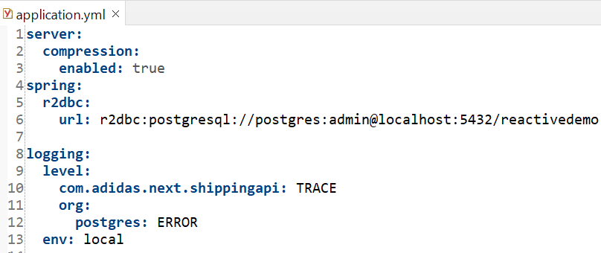
Application.yml
It is a file wherein we define the configuration data required for the project. AT application startup all the configurations are read from this file.
We can define configurations like database servers, logging ,change in port number etc.
Define PostgreSQL database and logging configuration.
CONFIGURATION
FILES

Slide 19
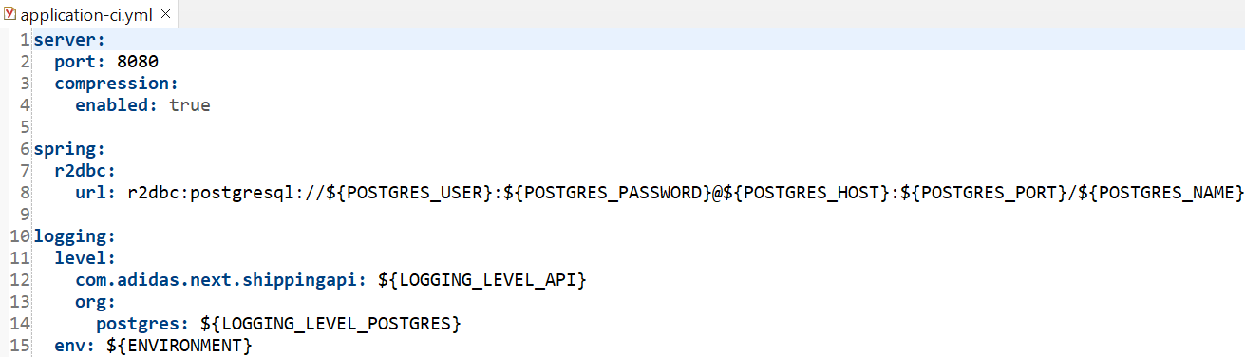
Application-ci.yml
Define PostgreSQL database and logging configuration.
While running the application via Docker desktop, the configuration will be picked up from the application-ci.yml file.
CONFIGURATION
FILES

Slide 20
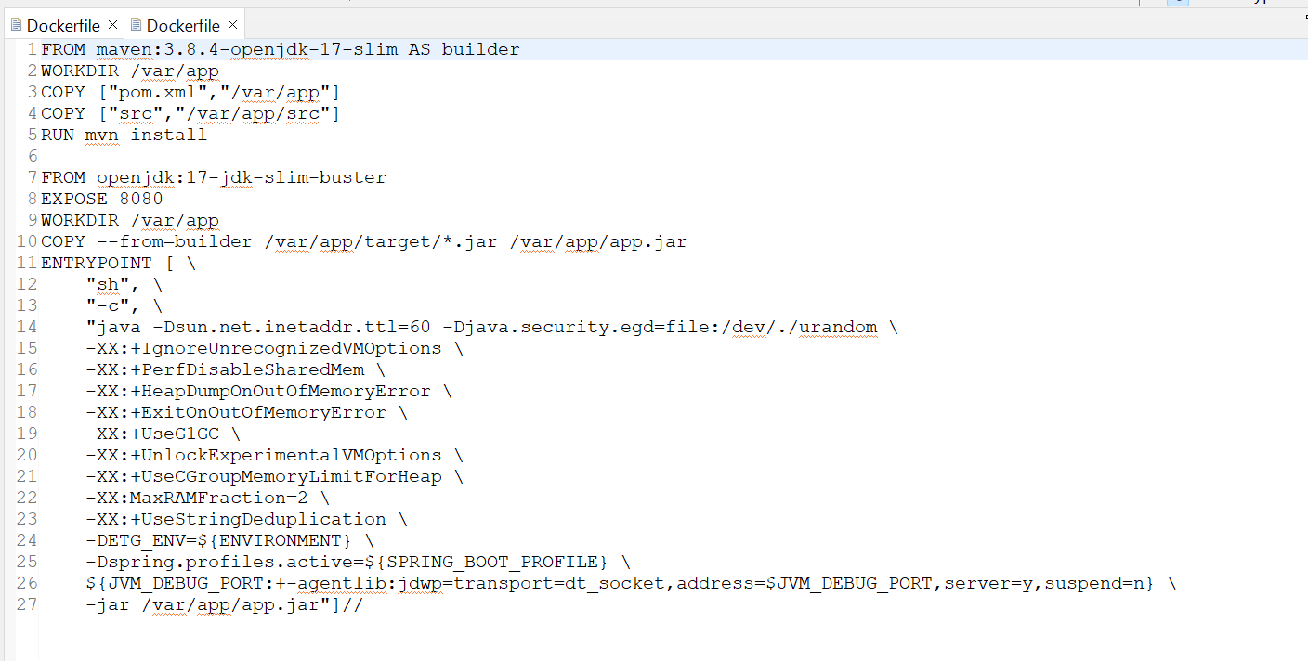
Dockerfile.yml
A Docker file is a text document that contains commands that are used to assemble an image.
Docker builds images automatically by reading the instructions from the Docker file. For example, jdk, maven etc.
CONFIGURATION
FILES

Slide 21
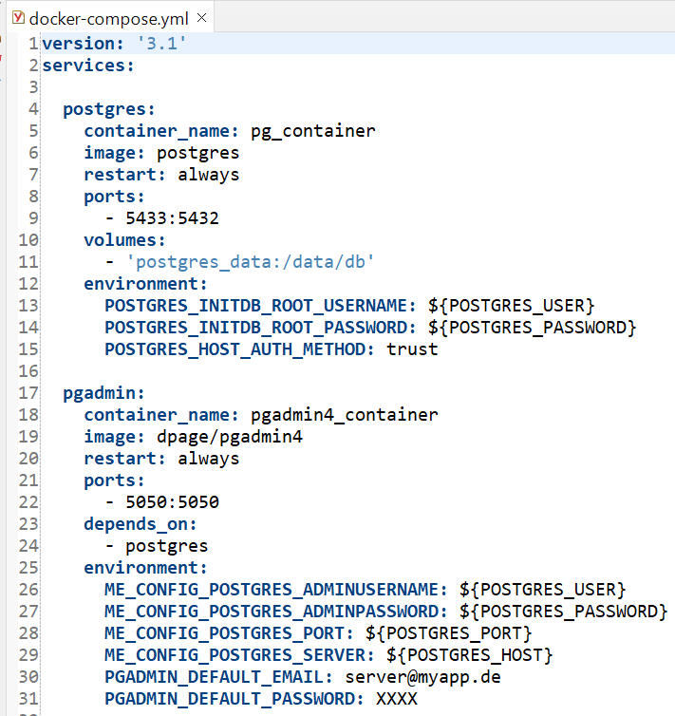
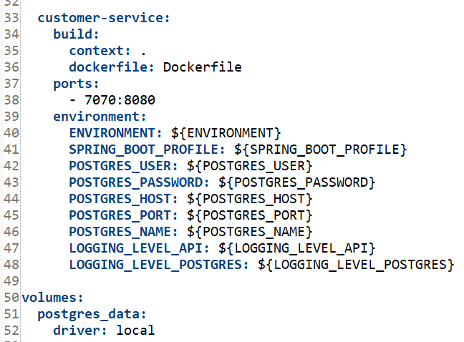
Dockercompose.yml
Define the services that make up your application in docker-compose.yml so they can be run together in an isolated environment.
Docker-compose.yaml file is used to run images.
CONFIGURATION
FILES

Slide 22
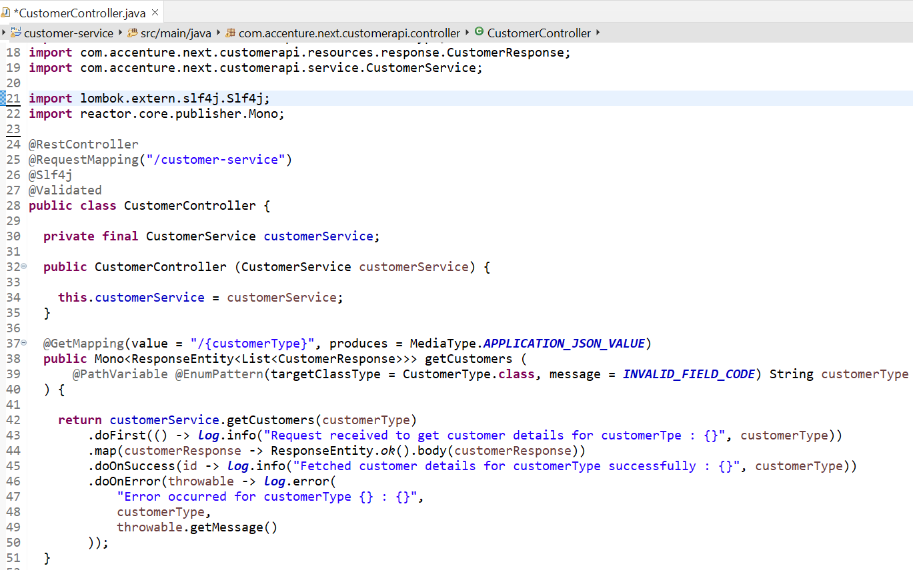
Controller Layer
Controller layer is responsible for processing incoming REST API and returning the view to be rendered as a response.
Define request mapping along with Get/Post/Put endpoints and calling service layer.
@RestController annotation is used to mark the class as a controller below.
We have defined a get endpoint that will return customer details based on Customer type.
KEY
CLASSES

Slide 23
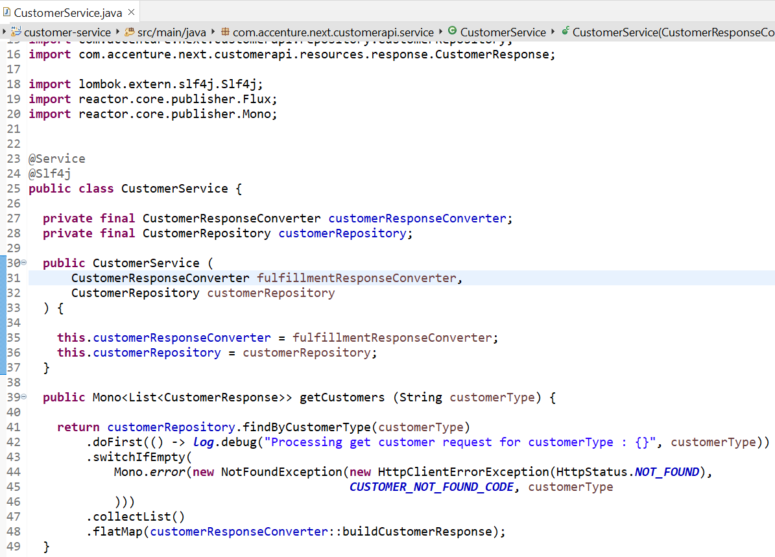
Service Layer
Layer that facilitates the communication between the controller and the persistence layer.
Holds the business logic.
@Service annotation used to annotate this as a service class.
KEY
CLASSES

Slide 24
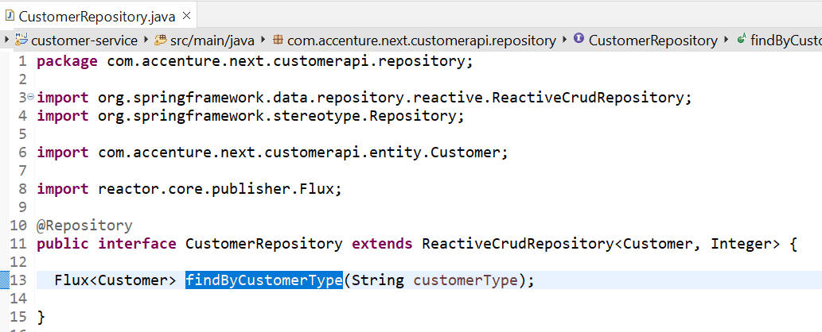
Repository Layer
Fetch a record from the database.
We have defined the function to find the customers and the return type will be Flux since there can be more than one customer belonging to the same category.
@Repository annotation is used to mark this class as a repository.
KEY
CLASSES

Slide 25
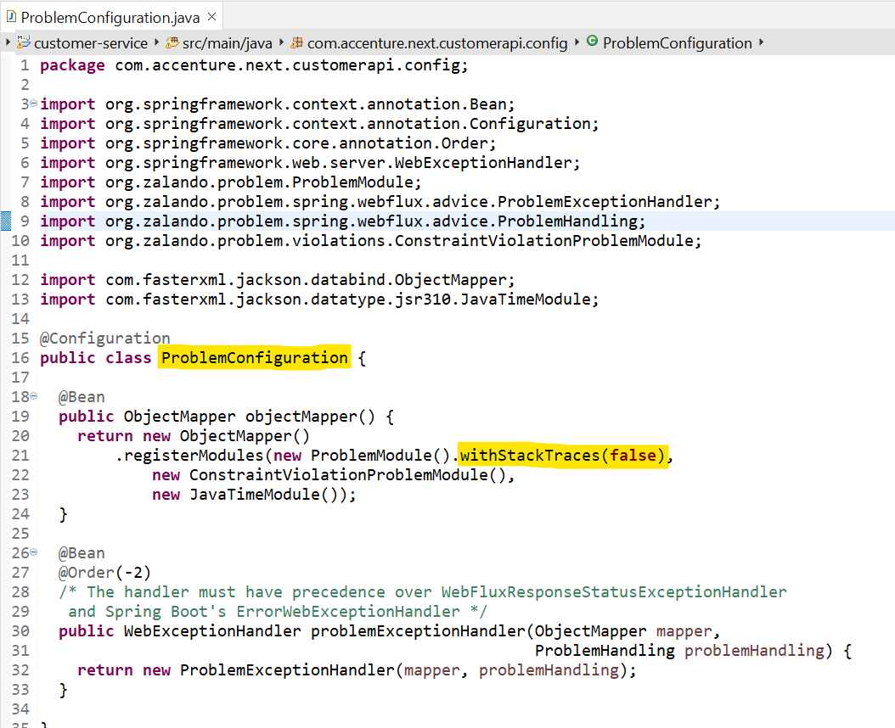
Exception Handling
Produce application/problem+json responses using the Problem Spring Web library. This library helps us to avoid repetitive tasks related to error handling.
By integrating Problem Spring Web into our Spring Boot application, we can simplify the way we handle exceptions within our project and generate responses accordingly.
KEY
CLASSES

Slide 26
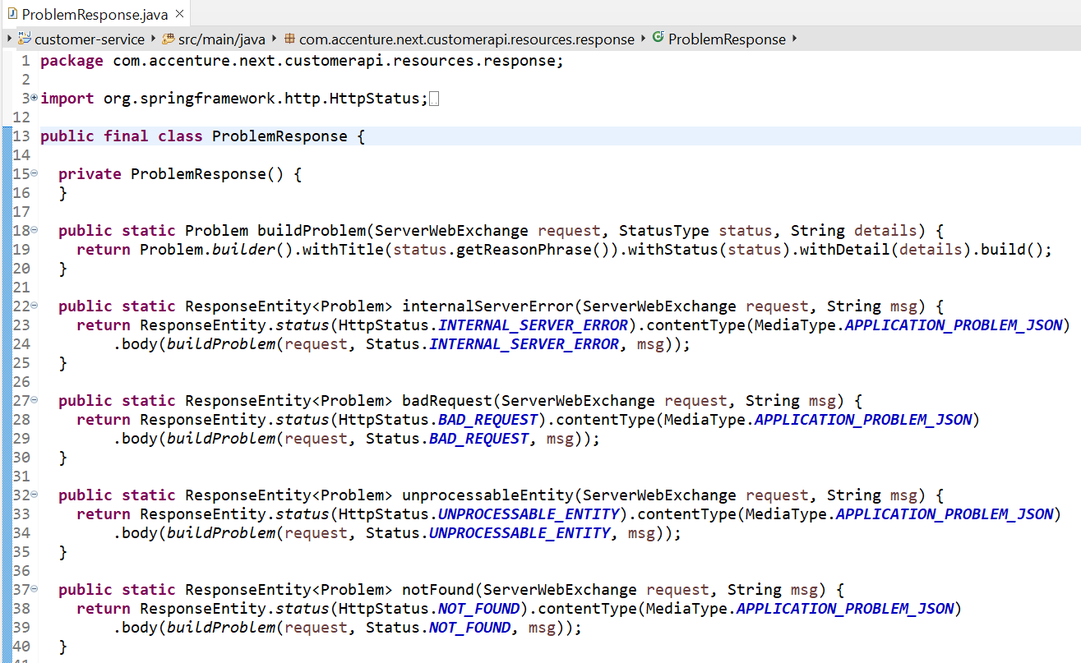
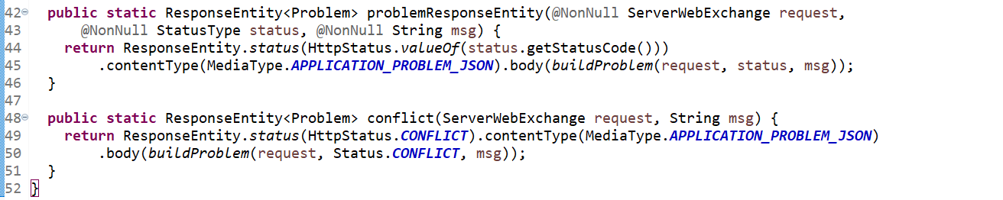
ProblemResponse Class
Preparing error responses with custom fields like Error title, status, and code.
KEY
CLASSES

Slide 27
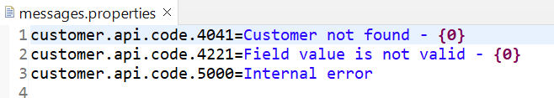
Message.Properties File
Define all the error messages in key-value format.
KEY
CLASSES

Slide 28
Local.env File
Define PostgreSQL database and logging configuration that is being picked-up when we run application using docker desktop.
KEY
CLASSES

Slide 29
Reactive Application Up and Running
We can run applications either using spring boot main class or docker desktop. To run docker-compose locally, run the following commands
cp local.env .env
docker-compose up -d --build
To stop running containers, run following commands
docker-compose down

Slide 30
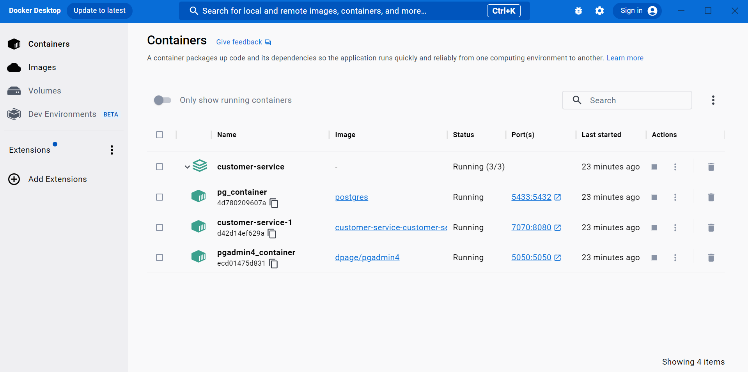
DOCKER
CONTAINER
IMAGES

Slide 31
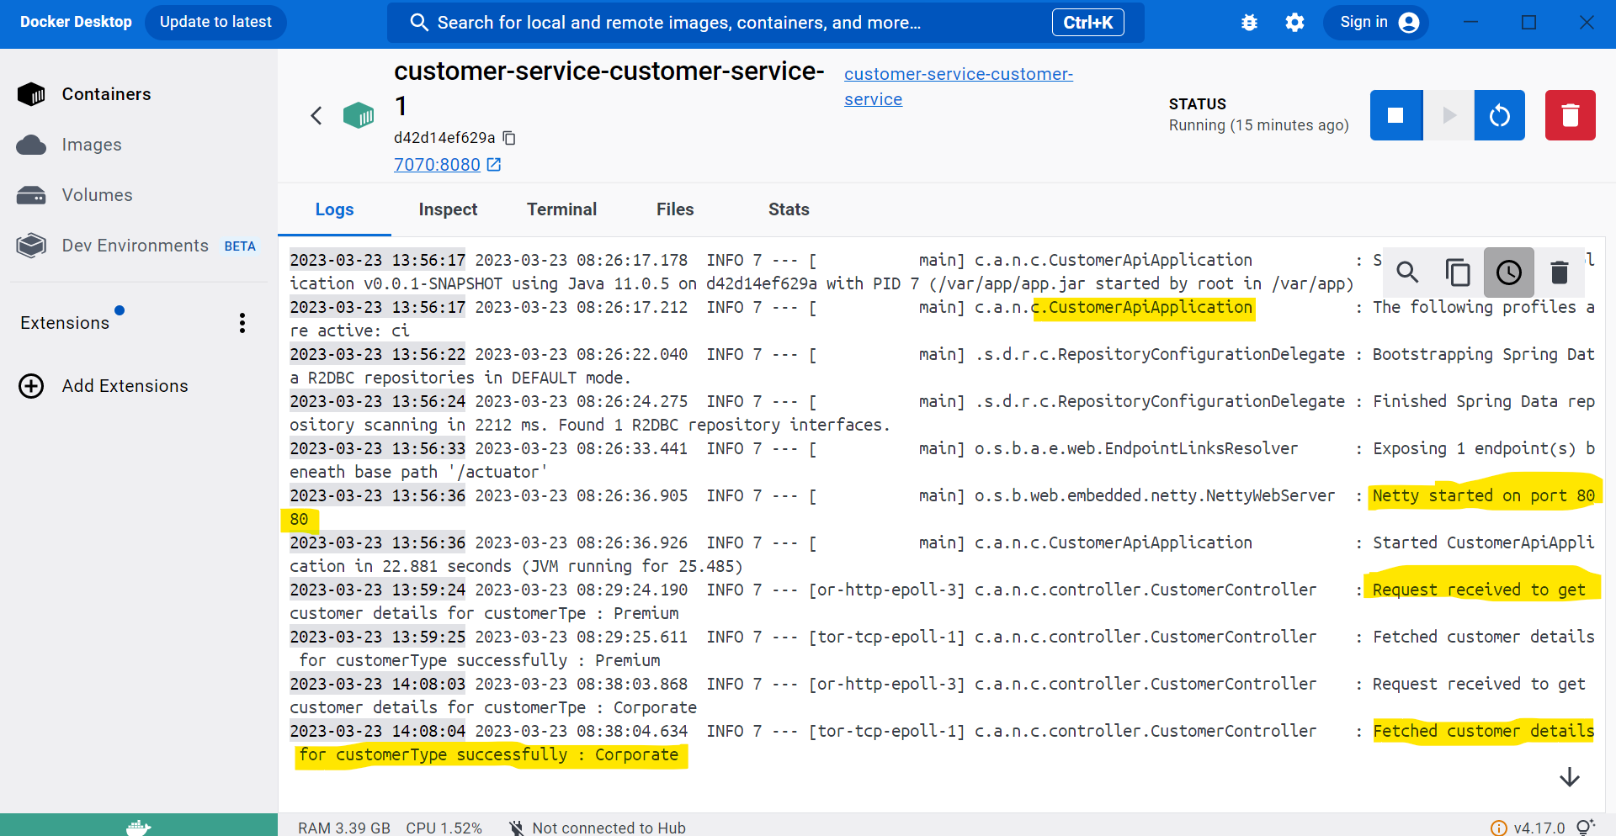
APPLICATION LOG
INSIDE DOCKER
CONTAINER

Slide 32
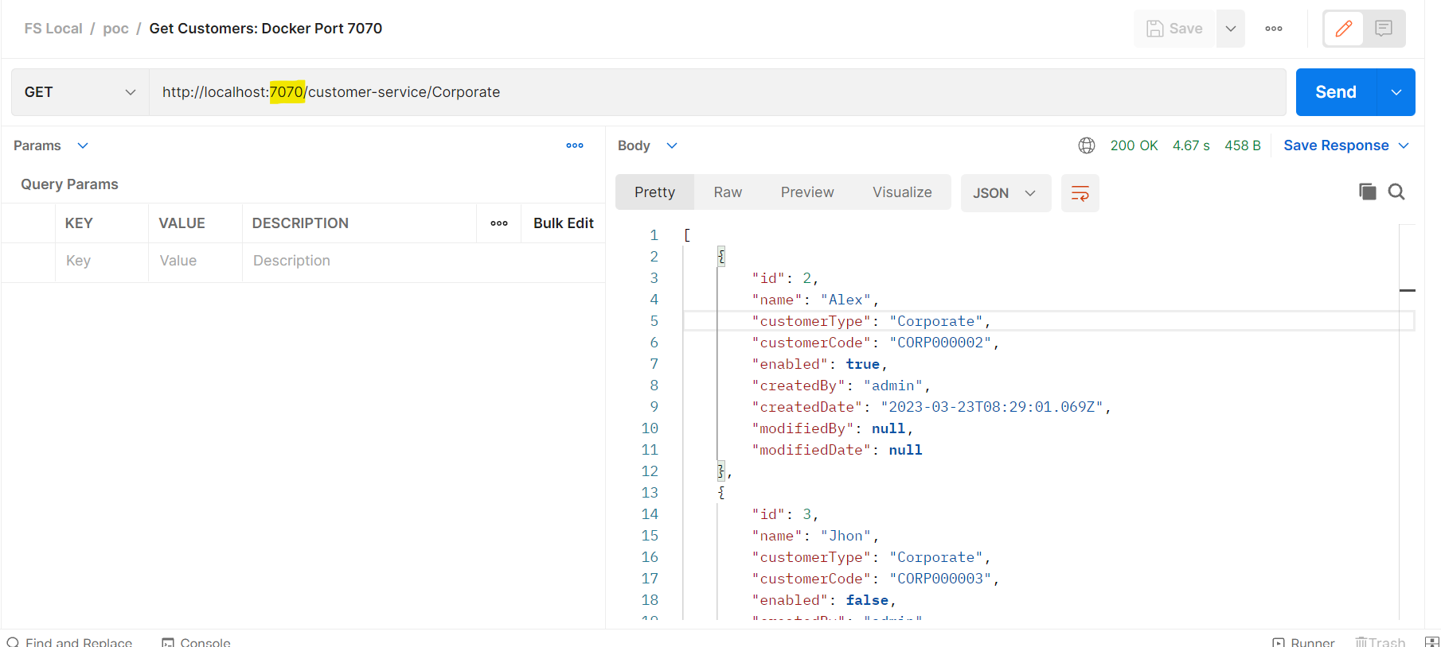
RESPONSE USING POSTMAN COLLECTION,APPLICATION RUNNING ON DOCKER 7070 port

Slide 33
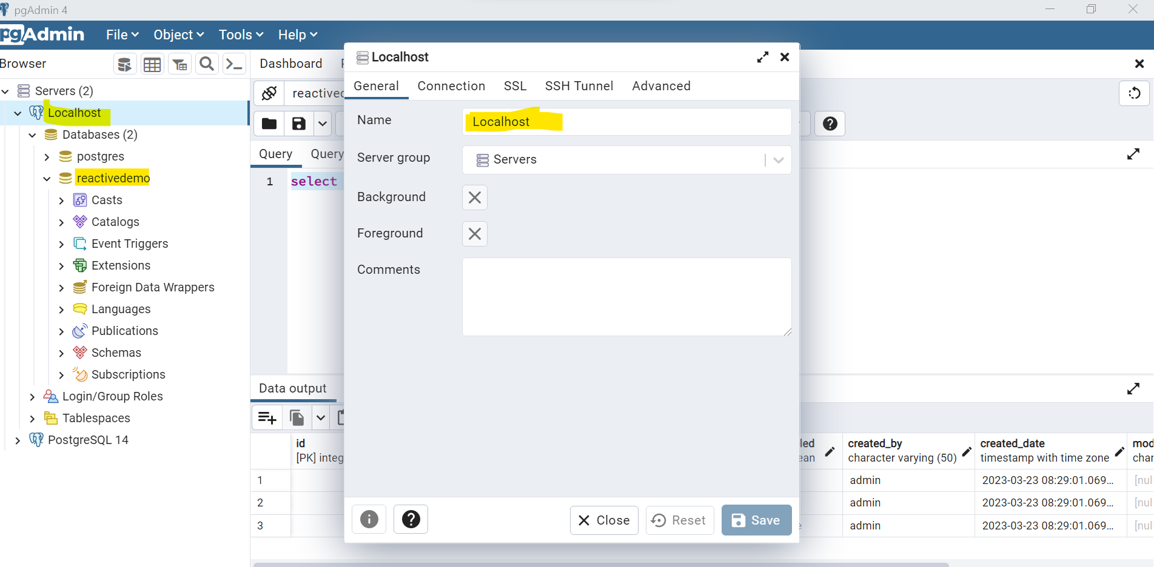
CONNECT RUNNING POSTGREs IMAGES WITH LOCAL PG ADMIN

Slide 34
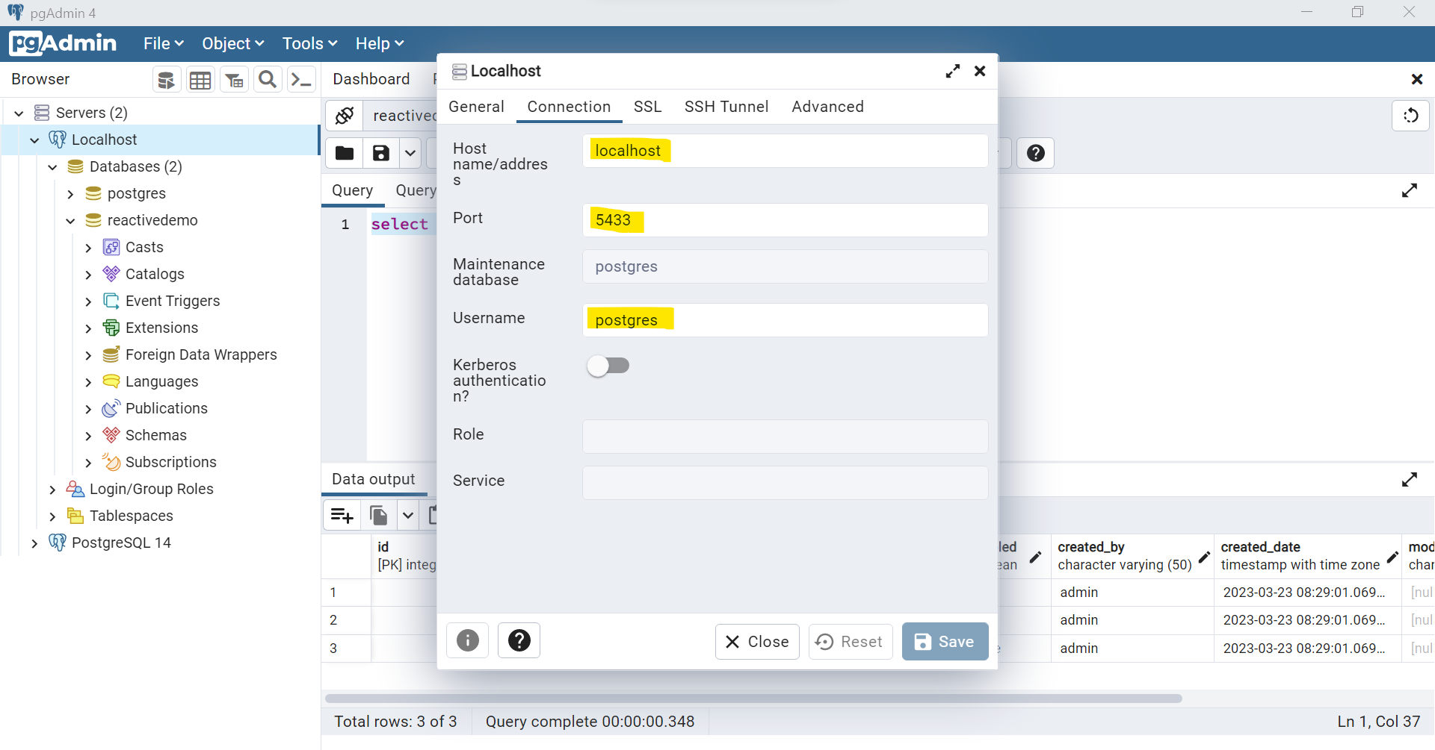
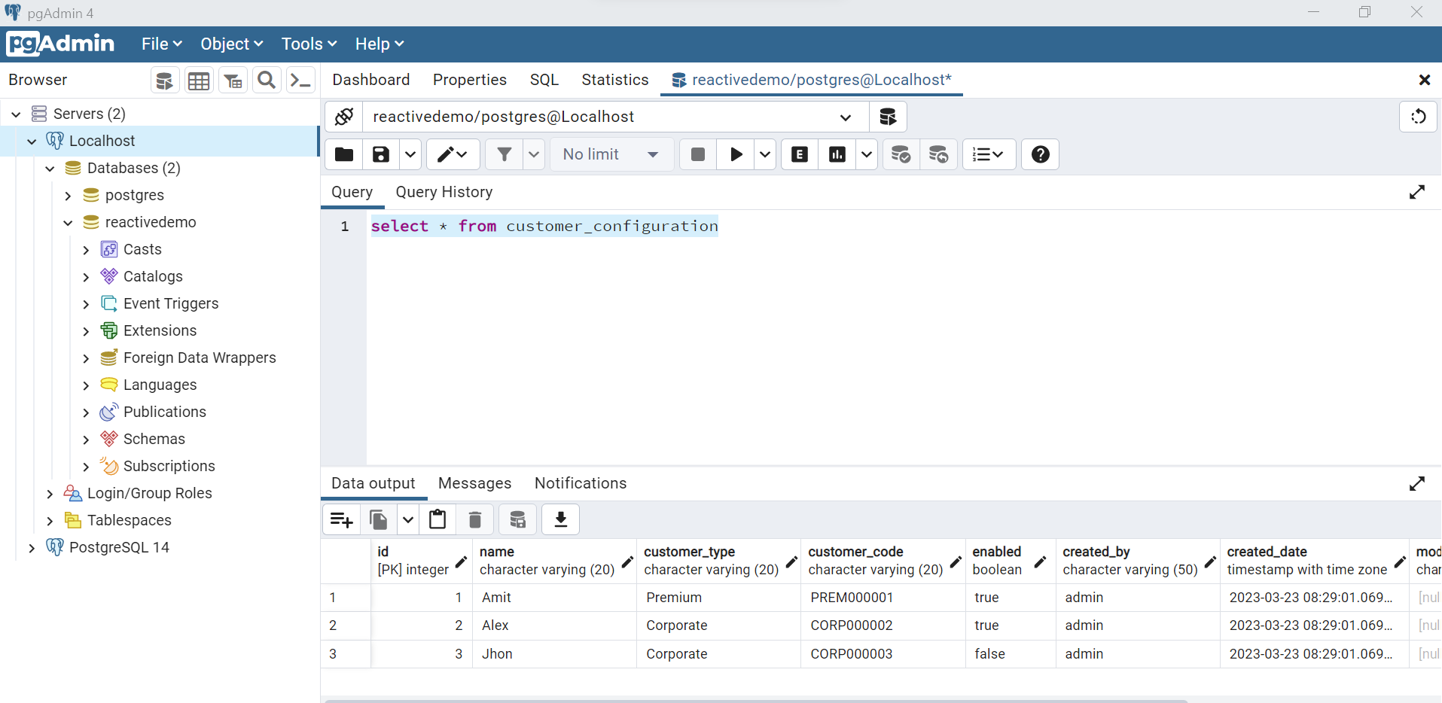
POSTGRES PORT IN DOCKER DIFFERENT FROM RUNNING IN LOCAL MACHINE

Slide 35


